Slide 1
Statechart Diagrams
Purpose:
  to specify the behavior of the instances of a given class in response to external stimuli formally
UML notation:
  a directed graph of states connected by transitions
Origins:
  finite state machines (formal set­based notation)
  state transition diagrams (formal graphical notation)
  Harel's statecharts (formal graphical notation )

Slide 2
NO FORMAL SPECIFICATION OF CLASS BEHAVIOR
The library borrower goes to the librarian and asks for a book. The librarian swipes the borrower card and the isbn number of the book using the barcode reader. If the borrower has not exceeded his/her quota and the book has not been reserved the borrower gets the book.

Slide 3
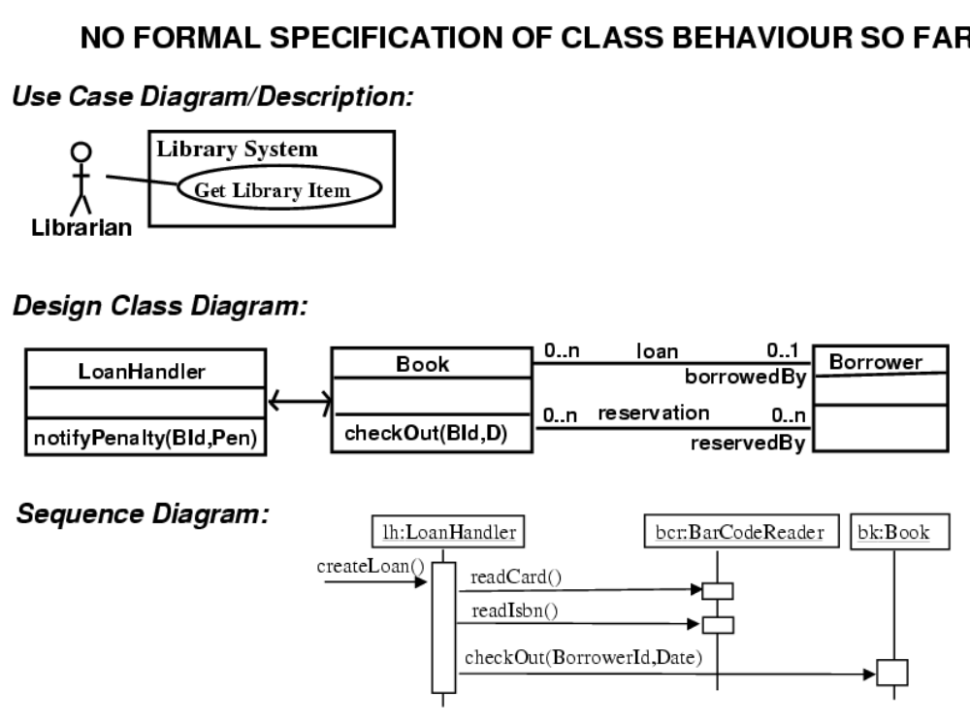

Slide 4
What is State?
A state is a condition during the life of an object or an interaction during which:
  it satisfies some condition
  performs some action
  waits for some event
An object remains in a state for a finite time

Slide 5
STATECHART DIAGRAM: The basic semantics
event: an occurrence of
        a change in the truth­value of a condition
        a receipt of a call for an operation
        the end of a designated period of time
state: a finite (not­instantaneous) period in the life of an object during which this object
        satisfies some condition; or
        performs some action; or
        waits for some event to occur
transition: a response to an event received by an object
which is in a certain state

Slide 6
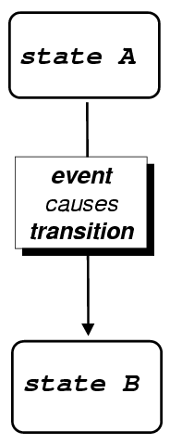

Slide 7
UML provides a graphical notation for representing these concepts which is introduced in the next slide

Slide 8
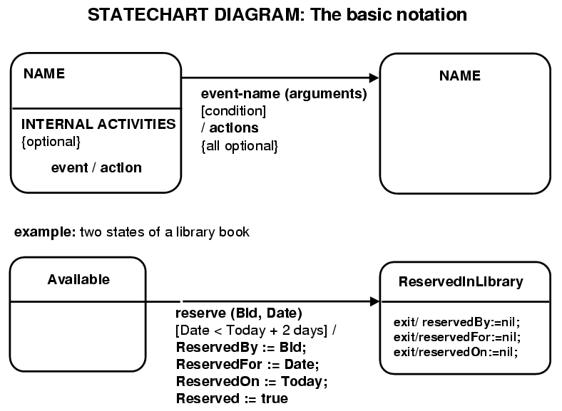

Slide 9
The next slide gives an example of specifying the behaviour of a library book using a statechart diagram

Slide 10
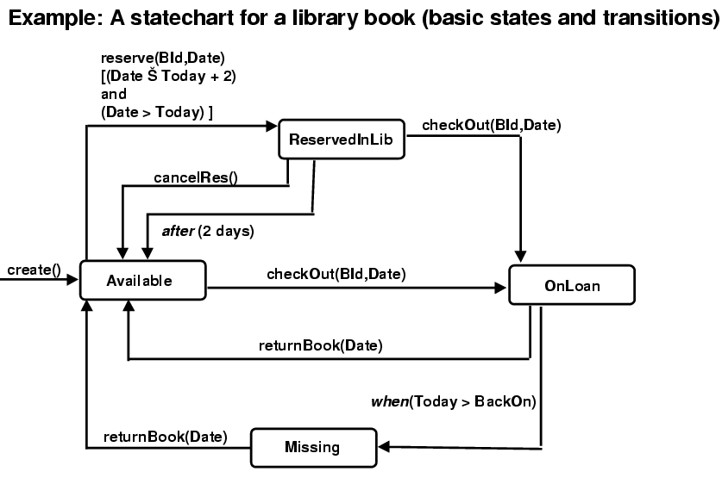

Slide 11
The library book statechart diagram may be expanded to specify:
  the actions that are triggered when the transitions fire
  the internal actions which are triggered by events which occur while the book is in each of its states but do not cause any state transition.

Slide 12
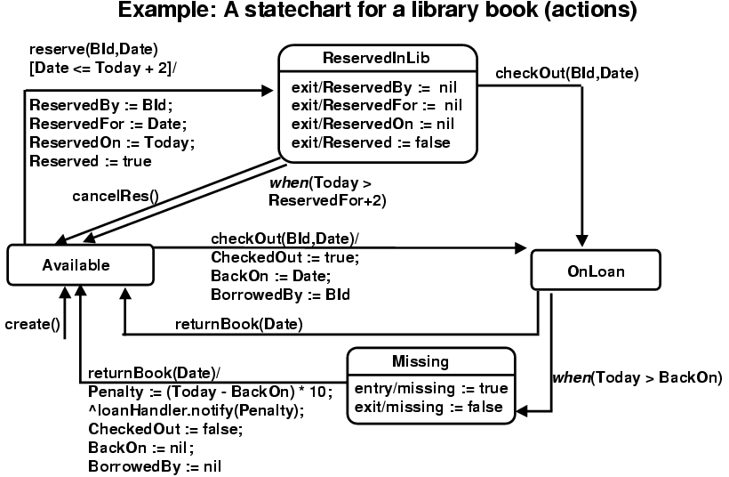

Slide 13
Composite states
A state can be decomposed into
  a set of concurrent substates known as and decoposition
  or a set of mutually exclusive substates known as or decomposition
A state which is decomposed into substates is called composite state

Slide 14
AND / OR Decomposition
Substates may also be decomposed in exactly the same way
The meaning of the or­decomposition is that when the composite state is 'active' the object might be in exactly one of its substates
The meaning of the and­decomposition is that when the object is in the composite state it is concurrently in all the concurrent substates

Slide 15
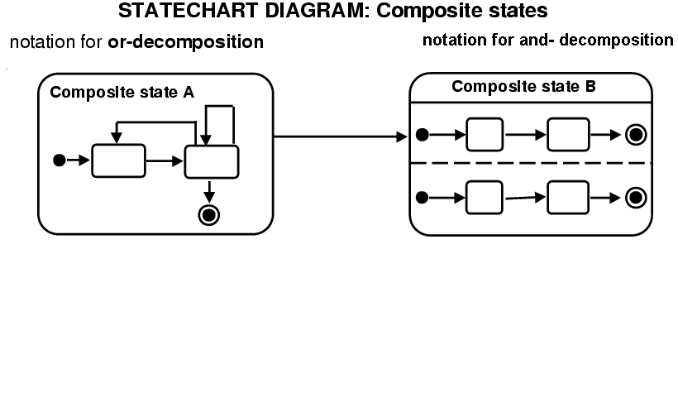

Slide 16
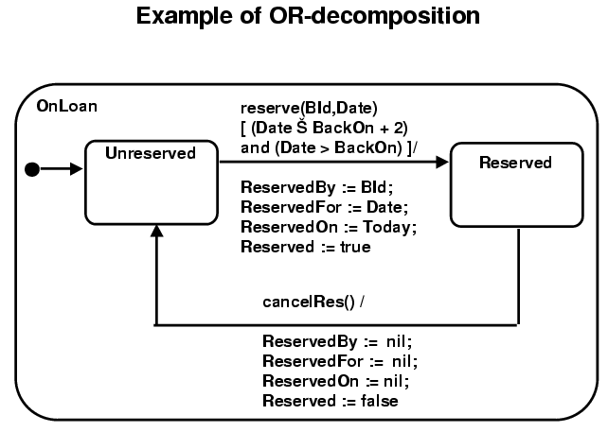

Slide 17
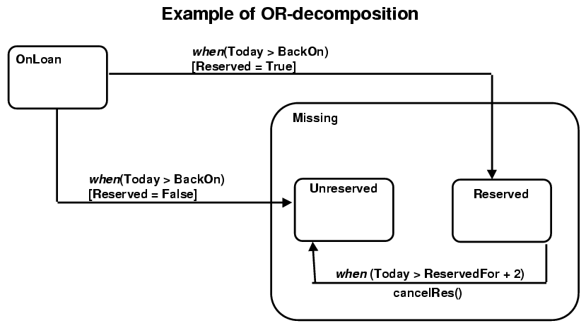

Slide 18
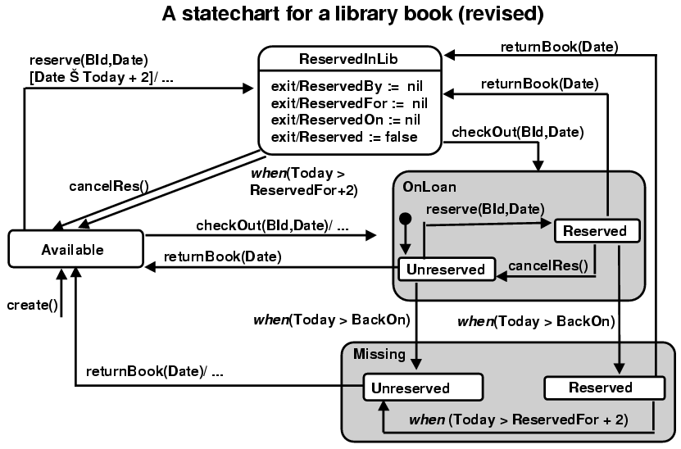

Slide 19
AND Decomposition

Slide 20
Role of statecharts in system development
The statechart diagrams:
  formally specify the behaviour of objects
  increase understanding of classes
describe what happens when stimuli and other kind of events occur within a system and its environment
provide abstract and partial descriptions of the actual code

Slide 21
Consistency between Statecharts and the Design class diagrams
Statecharts must be checked against the design class diagramm to ensure that:
  the messages which label transitions correspond to operations of the relevant class
  the attributes and associations which are referenced by transition and state actions have been defined for the relevant class
  the messages which are sent to other objects correspond to operations in the definition of the classes of these objects

Slide 22
Conclusions
Modelling class behaviour :
  is an essential part of design and the necessary final step before detailed coding
  requires an understanding of the different states in which the classes might be and the transitions between these states
  can be expressed using the Statechart notation of UML
  can be used to check other artefacts of system design

